Slide 1
Color Spaces

Slide 2
Color IP
Color is a powerful descriptor that often simplifies object identification and extraction from a scene.
Human can discern thousands of color shades and intensities, compared to about only two dozen shades of gray.

Slide 3
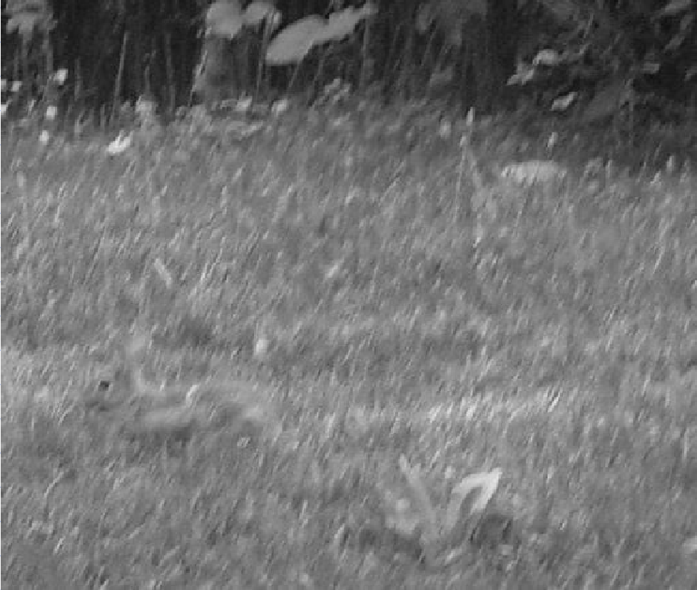
Preview

Slide 4
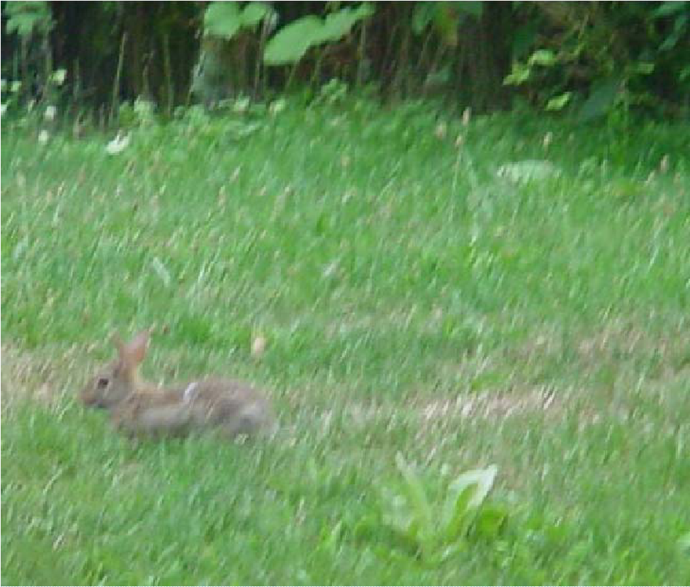
Preview

Slide 5
Types of IT
Color image processing is divide into two major area:
  Full-Color Processing
  Pseudo-Color Processing

Slide 6
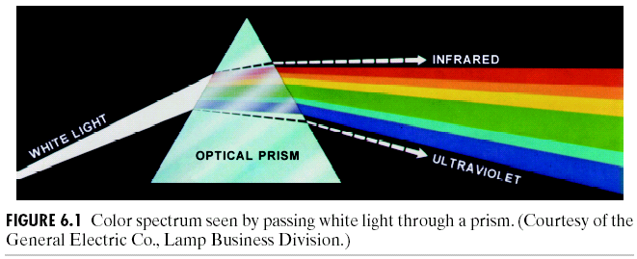
Color Fundamentals
The experiment of Sir Isaac Newton, in 1666.

Slide 7
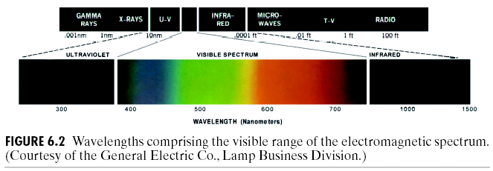
Color Fundamentals…

Slide 8
Color Fundamentals…
Basic quantities to describe the quality of light source:
  Radiance: Total amount of energy that flows from the light source (in W).
  Luminance: A measure of the amount of energy an observer perceives from the light source (in lm)
  Brightness: A subjective descriptor that embodies the achromatic notion of intensity and is practical impossible to measure.

Slide 9
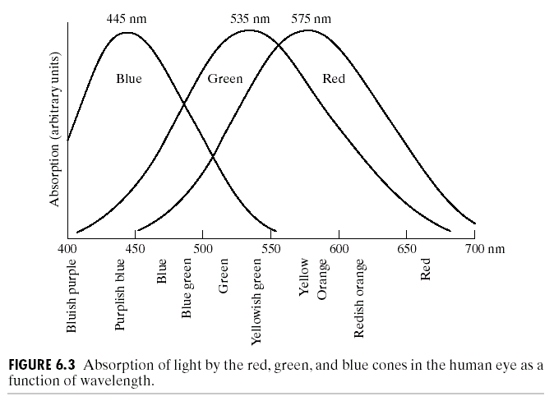
Color Fundamentals…
Standard wavelength values for the primary colors

Slide 10
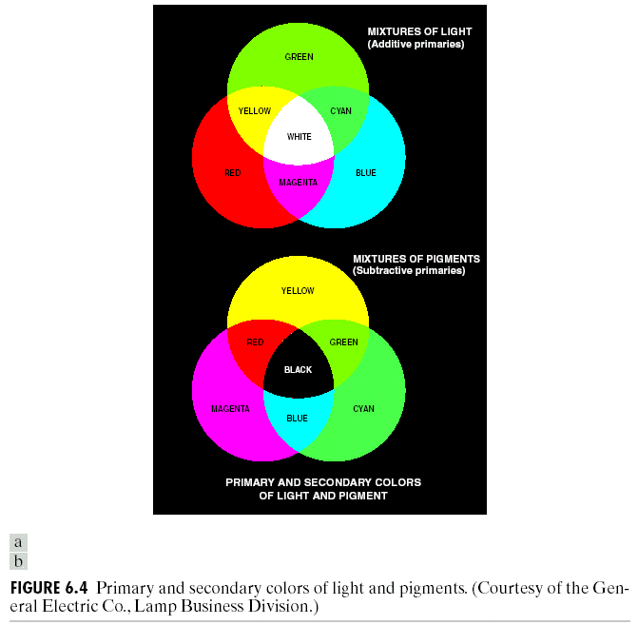
Color Fundamentals…

Slide 11
Color Fundamentals…
The characteristics generally used to distinguish one color from another are Brightness, Hue, and Saturation.
  Hue: Represents dominant color as perceive by an observer.
  Saturation: Relative purity or the amount of white light mixed with a hue
Hue and saturation taken together are called Chromaticity, and therefore, a color may be characterized by its Brightness and Chromaticity.

Slide 12
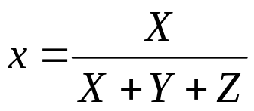
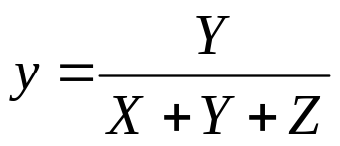


Color Fundamentals…
Tri-stimulus values: The amount of Red, Green and Blue needed to form any particular color
Denoted by: X, Y and Z
Tri-chromatic coefficient:

Slide 13
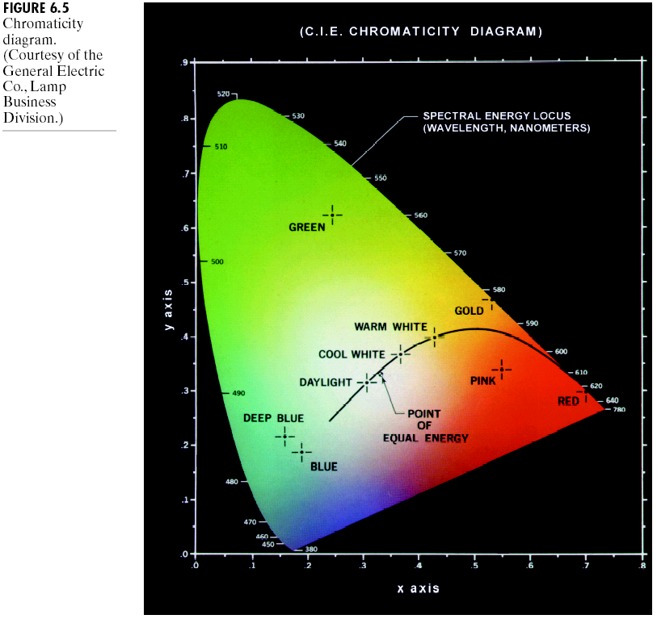
Chromaticity Diagram
Green Point =
62% green,
25% red,
13% blue.

Slide 14
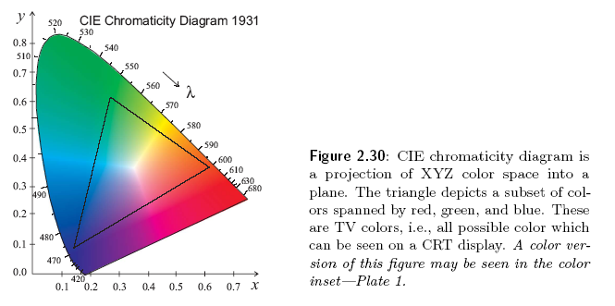

Slide 15
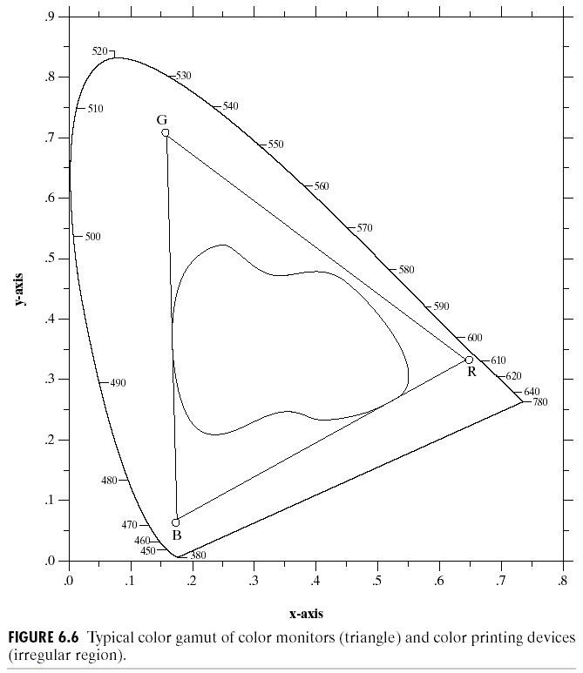
Chromaticity Diagram
Color Gamut produced by RGB monitors
Color Gamut produced by high quality color printing device

Slide 16
Color Models
The purpose of a color model (also called color space or color system) is to facilitate the specification of colors in some standard, generally accept way.
RGB (red,green,blue) : monitor, video camera.
CMY(cyan,magenta,yellow),CMYK (CMY, black) model for color printing.
and HSI model,which corresponds closely with the way humans describe and interpret color.

Slide 17
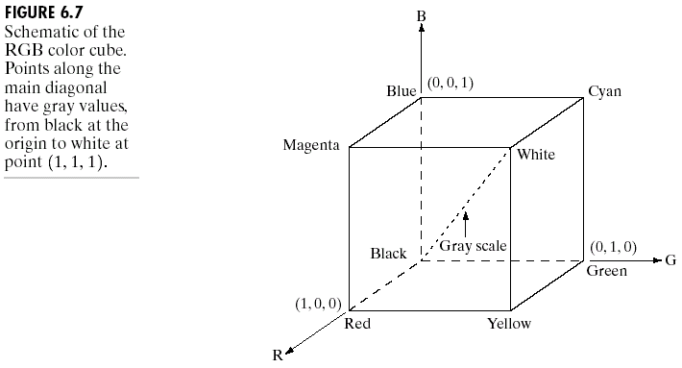
The RGB Color Models

Slide 18
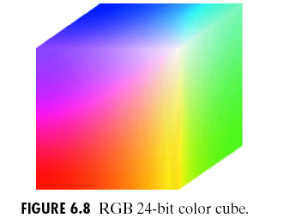
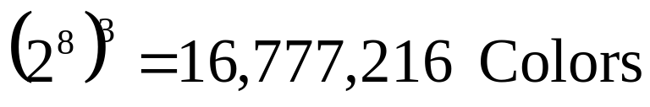
The RGB Color Models

Slide 19
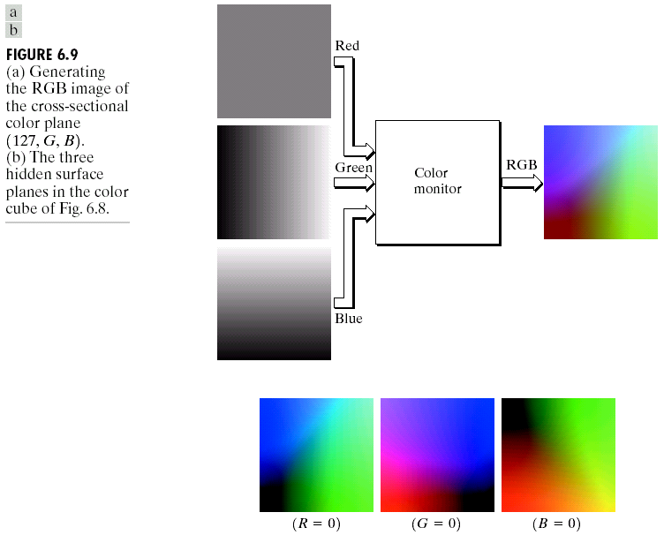






The RGB Color Models

Slide 20
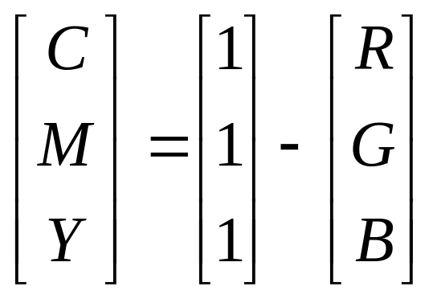
The CMY and CMYK Color Models
Cyan, Magenta and Yellow are the secondary colors of light
Most devices that deposit colored pigments on paper, such as color printers and copiers, require CMY data input.

Slide 21
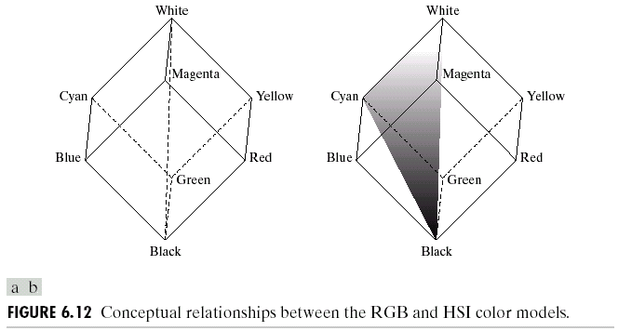
The HSI Color Models

Slide 22
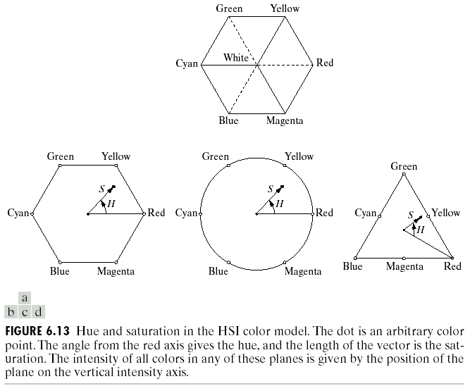
The HSI Color Models

Slide 23
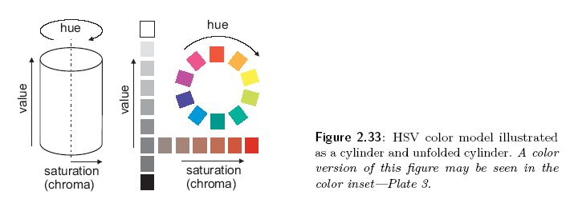

Slide 24
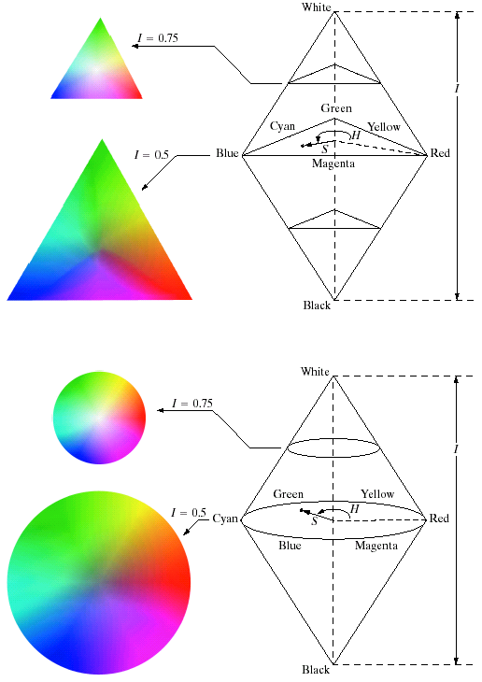

The HSI Color Models

Slide 25
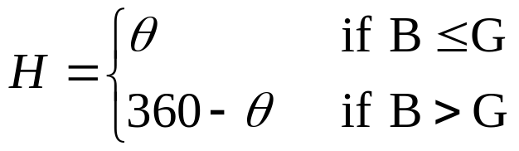
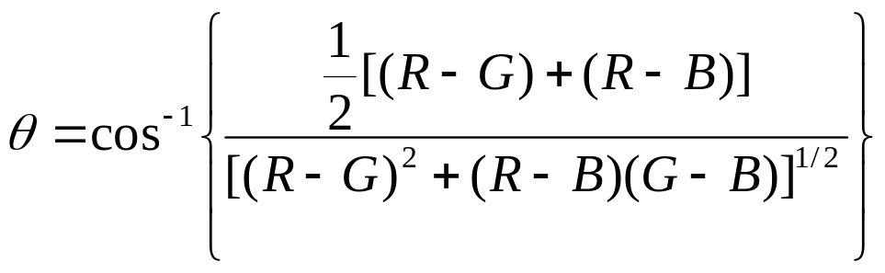
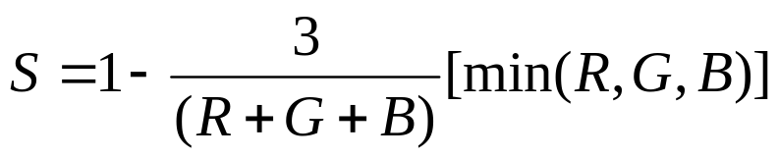
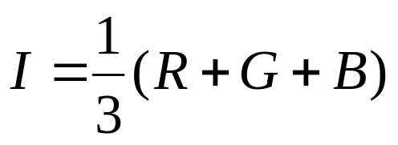
The HSI Color Models
Converting colors from RGB to HSI

Slide 26


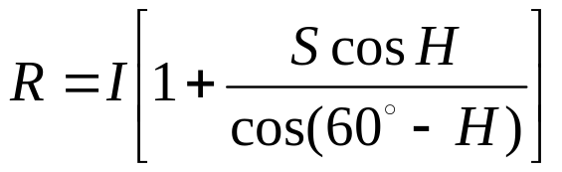

The HSI Color Models
Converting colors from HIS to RGB
  RG sector :

Slide 27



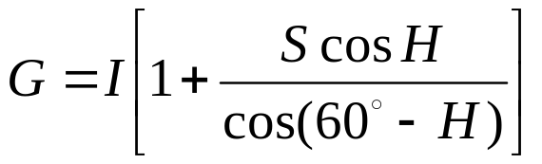

The HSI Color Models
Converting colors from HIS to RGB
  GB sector :

Slide 28





The HSI Color Models
Converting colors from HIS to RGB
  BR sector :

Slide 29
Pseudo color Image Processing
Pseudocolor (also called false color) image processing consists of assigning colors to gray values based on a specified criterion.
The principal use of pseudocolor is for human visualization and interpretation of gray-scale events in an image or sequence of images.

Slide 30
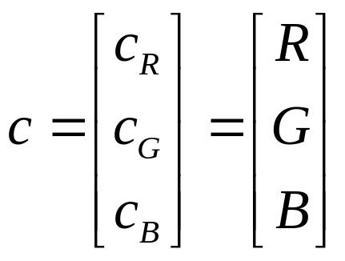
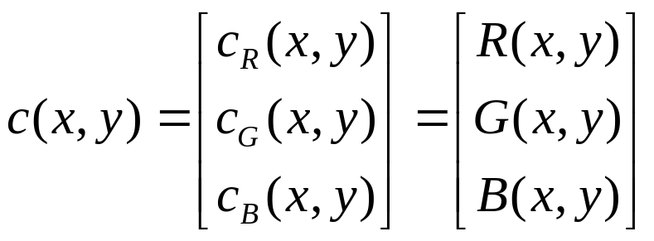
Basic of Full Color Image Processing
Let c represent an arbitrary vector in RGB color space
For an image of size M*N,

Slide 31
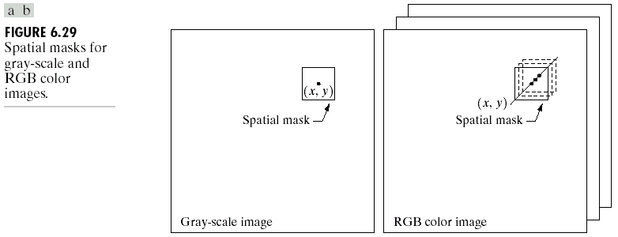
Basic of Full Color Image Processing

Slide 32
Basic of Full-Color Image Processing
Major categories of full-color Image processing:
  Per-color-component processing
  Vector-based processing

Slide 33
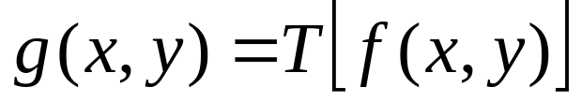
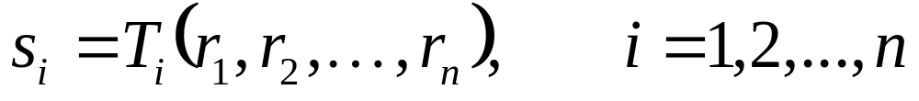
Basic of Full-Color Image Processing
Color Transformation
Processing the components of a color image within the context of a single color model.
Color components of g
Color components of f
Color mapping functions

Slide 34
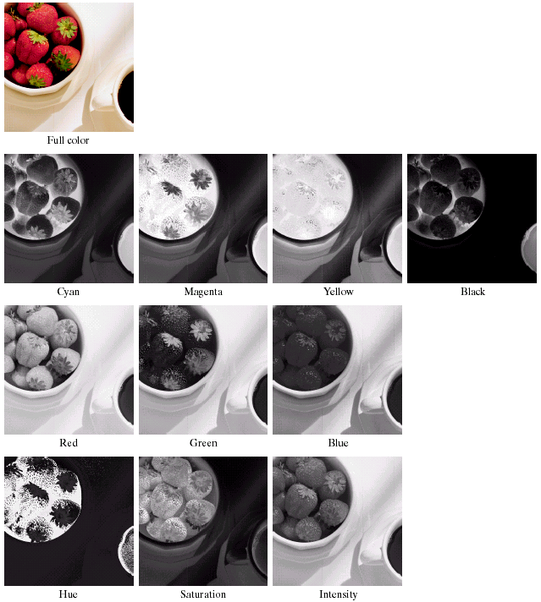
Full-Color Image Processing
Color Transformation
CMYK
RGB
HSI

